Slide 1
Module 3: Optical Sources LED Structures and Lasers
EXTC – BE – Optical Communication (ECC703)
Prof. Shyamala Mathi
Assistant Professor
Dept. of Electronics and Telecommunication,
SIES Graduate School of Technology

Slide 2
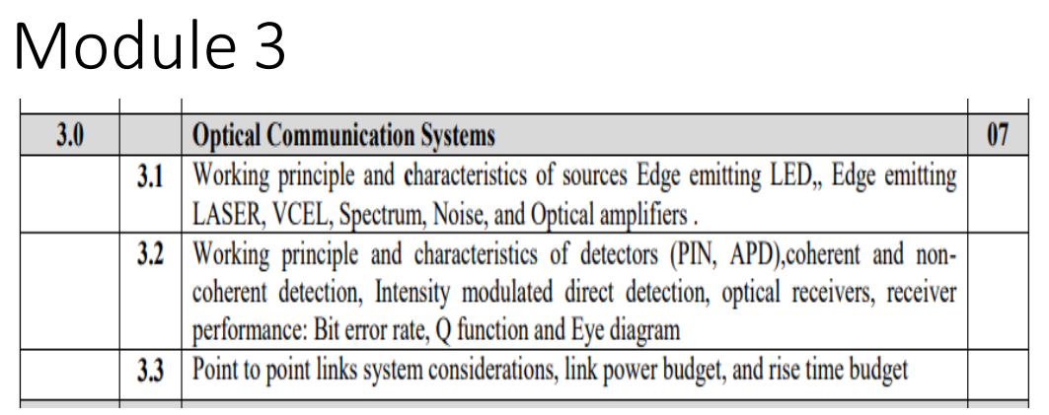

Slide 3
Semiconductor materials:
There are numerous compound semiconductors, which are composed of two or more elements.
Elemental Semiconductor – Single element Semiconductor (group IV element)
Binary Semiconductor – Semiconductor compound consisting of two elements .
Eg – GaP (Indirect), GaAs (Direct) - combination of gallium (Ga) from column III and arsenic (As) from column V (high quantum efficiency at low wavelength.
3. Ternary Semiconductor - Semiconductor compound consisting of three elements.
Eg – GaAs(1-x)Px, Al_{x}Ga(1-x)As - both Al and Ga are from column III and the subscript x is related to the composition of the two elements from 100 percent Al (x = 1) to 100 percent Ga (x = 0). When x<0.45, the semiconductor becomes direct bandgap semiconductor material else indirect bandgap material.
Quaternary Semiconductor - Semiconductor compound consisting of four elements. This semiconductor is suitable for longer wavelength region.
Eg – In(1-x)GaAsyP(1-y), Ga(1-y)AlyAs(1-x)Sbx

Slide 4
Homojunctions and Heterojunctions:
There are two types of semiconductor junctions:
Homojunctions – Material on the either side of junction has essentially the same energy bandgap.
Heterojunctions – the two sides of the junction are based on different semiconducting materials with different bandgaps.

Slide 5
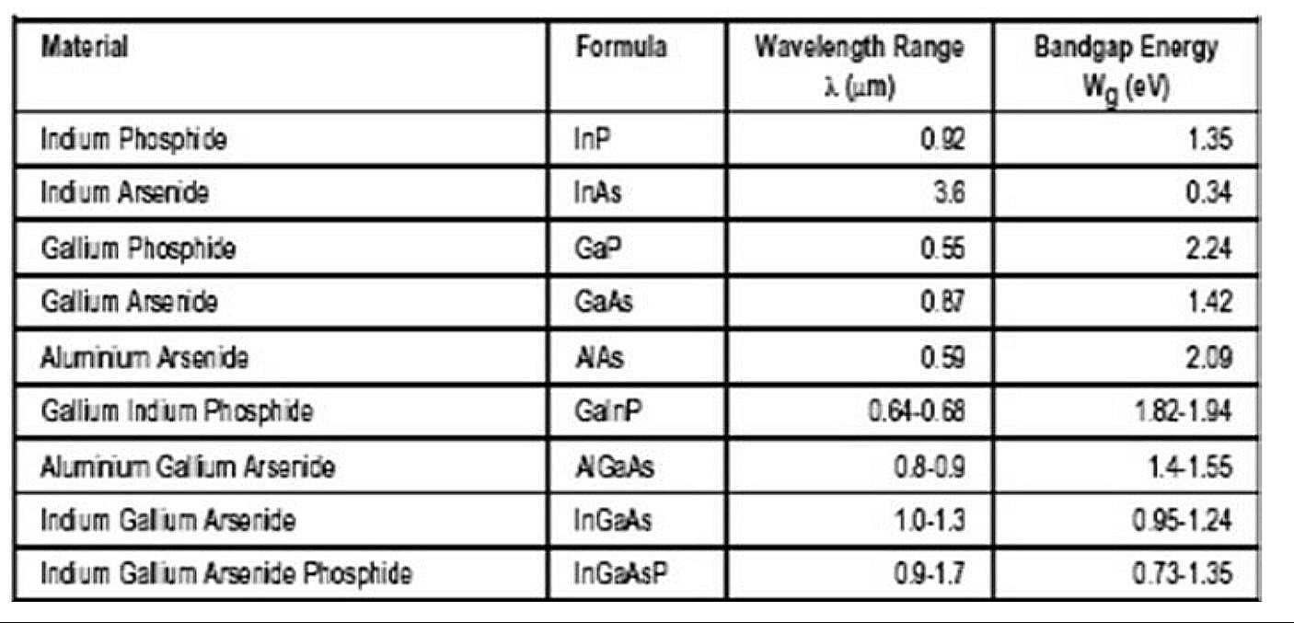
Some common material systems used in the fabrication of electroluminescent sources for optical fiber communications
GaAs – wavelength range = 0.78 micrometer to 1.4 micrometer
Infrared region

Slide 6
Double Heterojunction LED
Electroluminescence phenomenon

Slide 7
LED Structures:

Slide 8
The flux of radiation emitted per unit solid angle in a given direction by a unit area of a source.

Slide 9
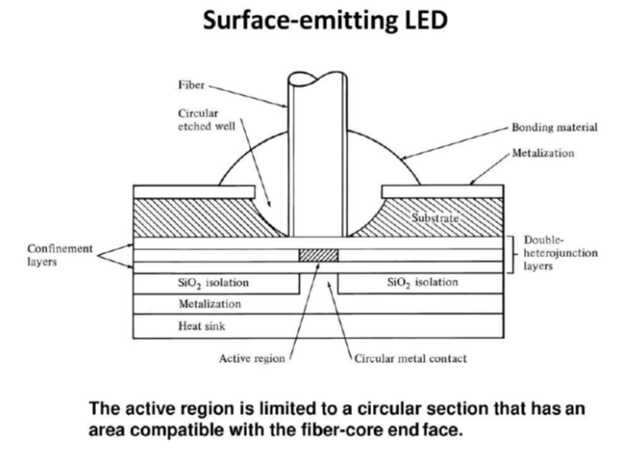

Slide 11
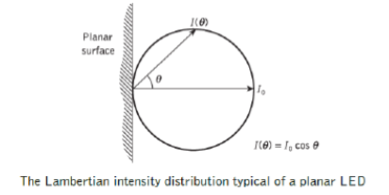

Slide 18
The internal quantum efficiency of LEDs decreases exponentially with increasing temperature and thus output power decreases.

Slide 27
By application of High intense radiation such as optical flash tube or High freq radio field

Slide 28

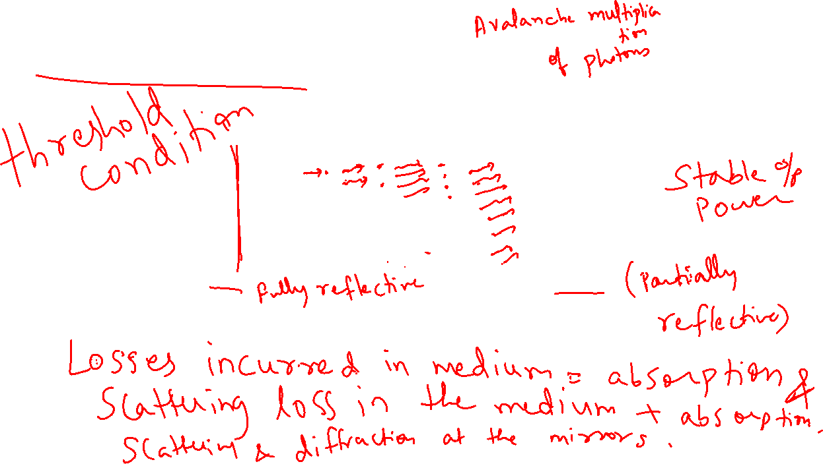

Slide 29
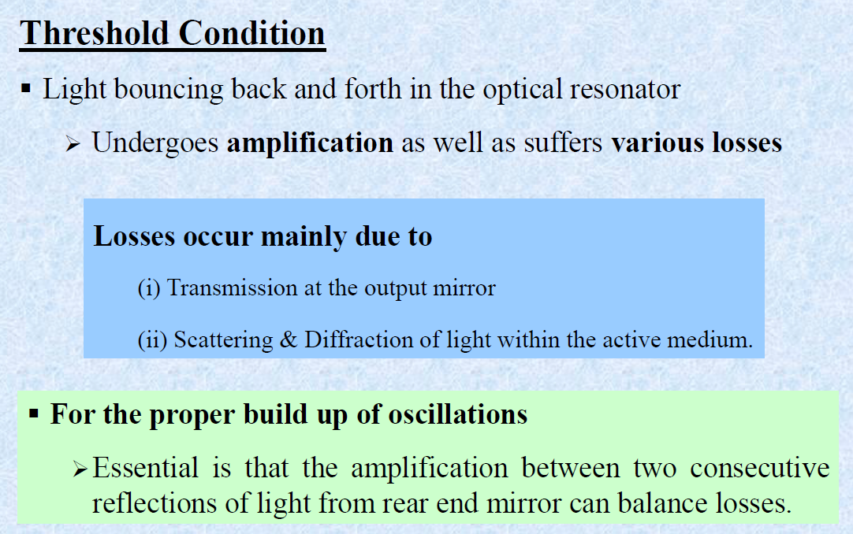

Slide 30
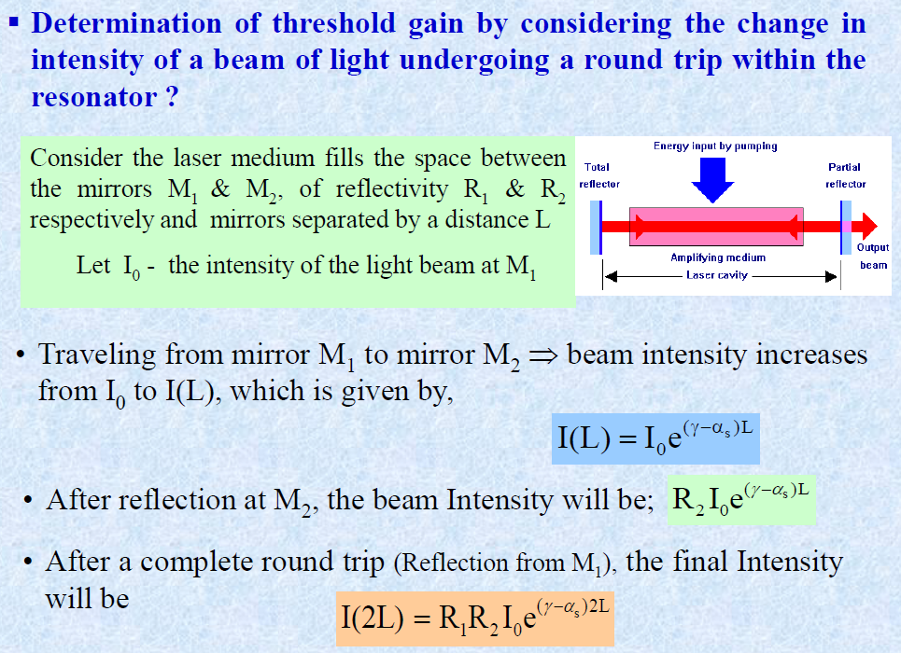

Slide 31
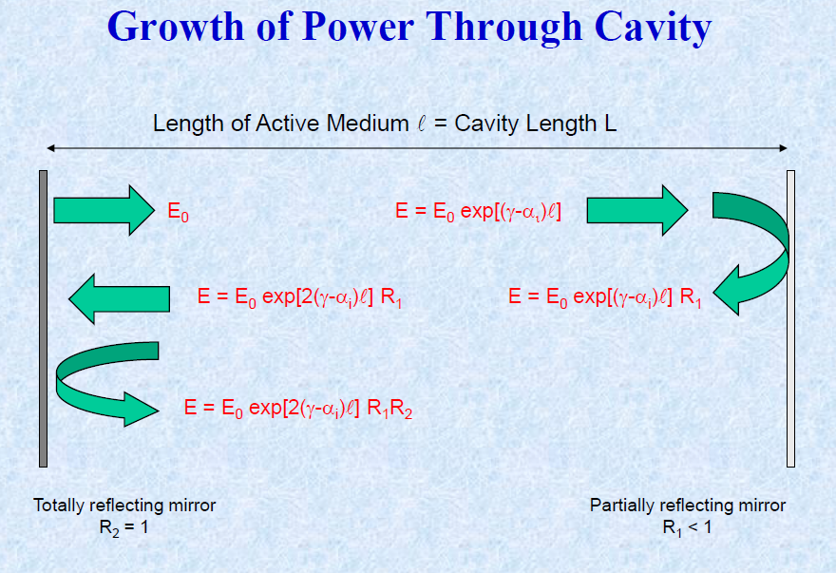

Slide 32
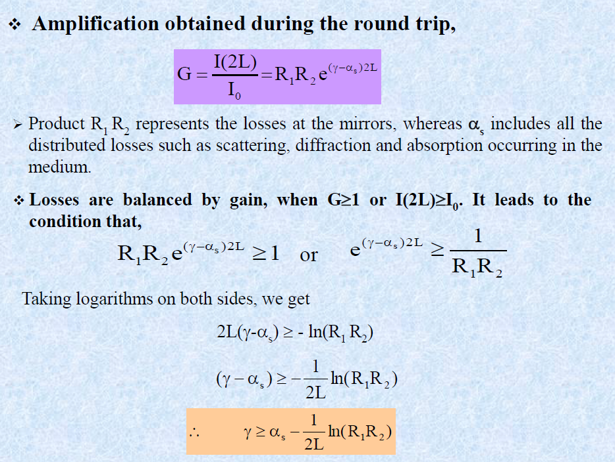

Slide 38
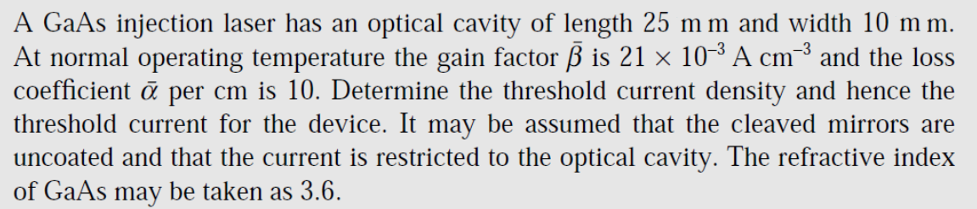

Slide 39
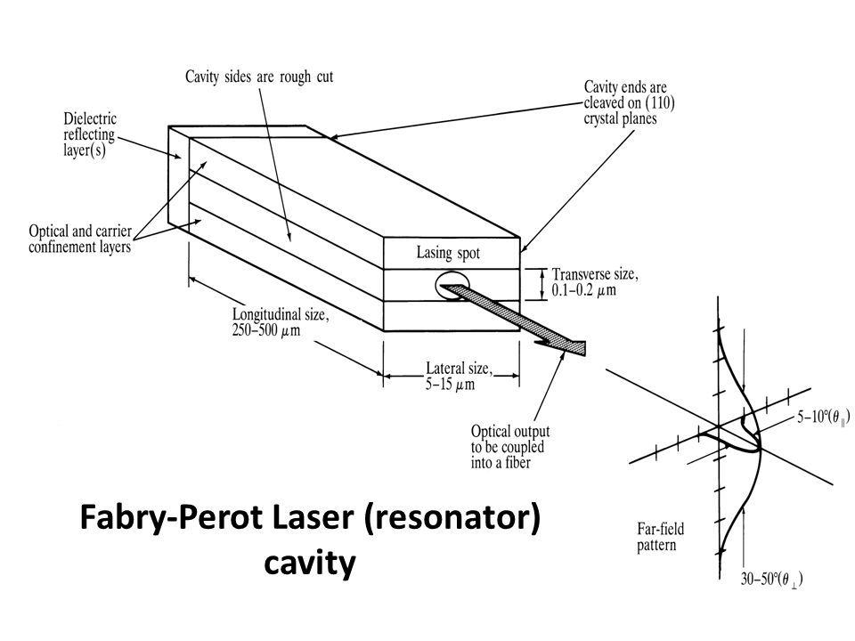

Slide 40
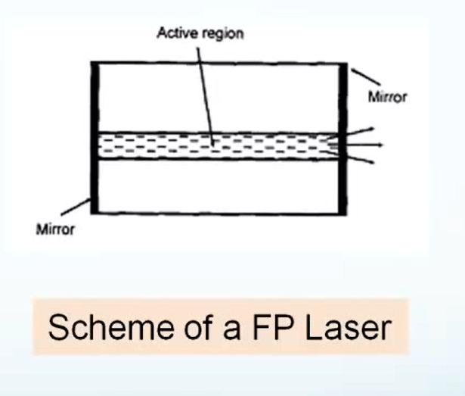

Slide 41
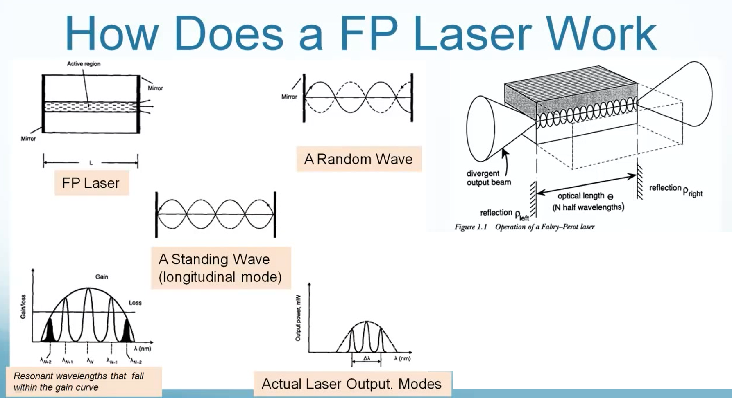

Slide 44
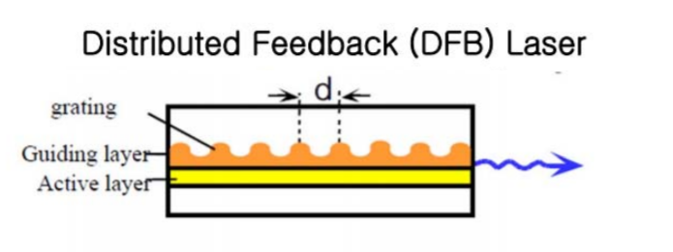
Distributed Feedback Laser

Slide 45
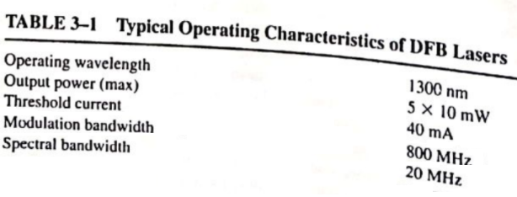

Slide 46
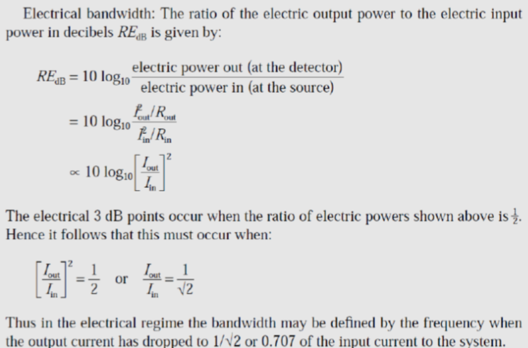
Bandwidth: It is the range of frequencies where power drops by 3 dB.

Slide 47
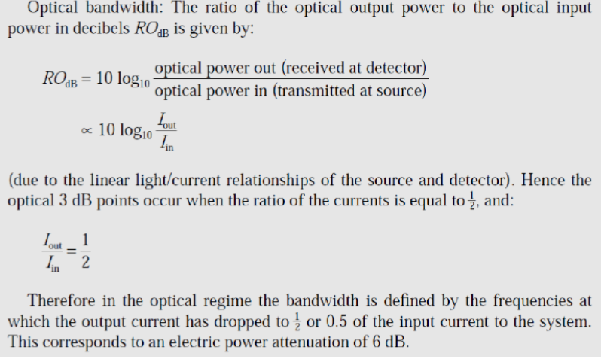

Slide 49
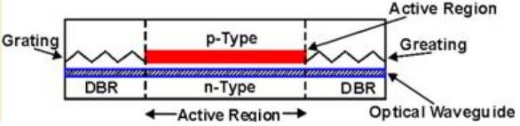
Distributed Bragg grating Laser

Slide 50
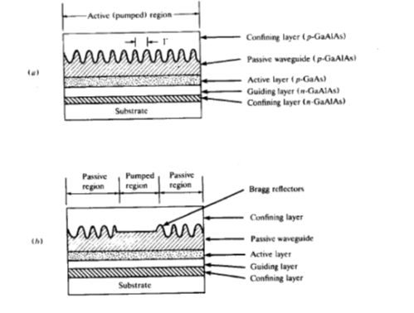

Slide 51
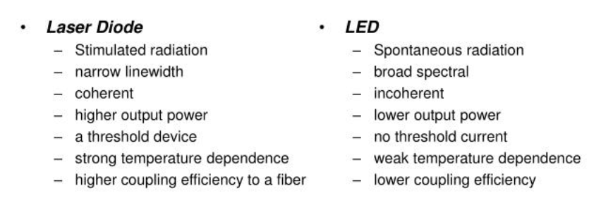

Slide 54
Lasers with double heterojunction

Slide 56
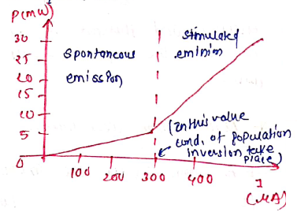


Slide 61
Thank You!
(shyamalae@sies.edu.in)

